Slide 1
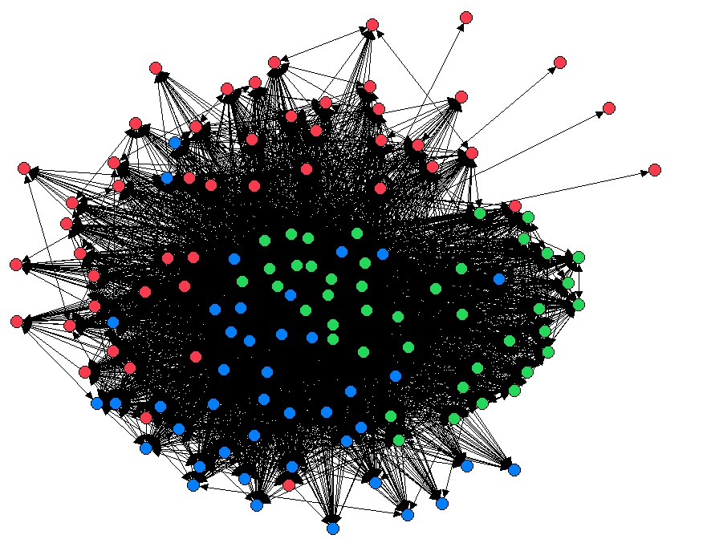
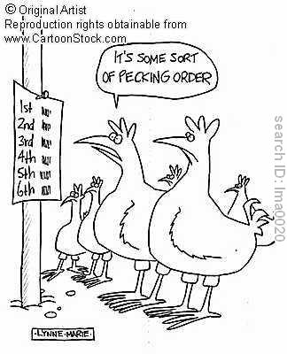
Week 4
Social Structure and Social Interaction Continued

Slide 2
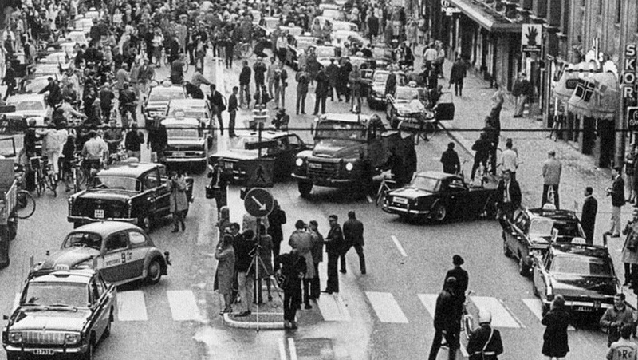
Predictable Relationships

Slide 3
Elements of Social Structure
Groups
Networks
Institutions
Functionalist vs. Conflict Perspective
Social Structure → Social Interaction
Zimbardo’s Prison Experiment
Thomas Theorem

Slide 4
Types of Groups
Primary vs. Secondary
In-Groups vs. Out-Groups
Reference Groups
Coalitions
Formal Organizations and Bureaucracies

Slide 5
Characteristics of a Bureaucracy
Ideal Type
Division of Labor
Alienation
Trained Incapacity
Hierarchy of Authority
Written Rules and Regulations
Goal Displacement
Impersonality
Technical Qualifications

Slide 6
Characteristics of Bureaucracy
Characteristic | Positive Consequences | Negative Consequences For the Individual For the Organization
Division of labor | Produces efficiency in large-scale corporation | Produces trained incapacity | Produces a narrow perspective
Hierarchy of authority | Clarifies who is in command | Deprives employees of a voice in decision making | Permits concealment of mistakes
Written rules and regulations | Workers know what is expected of them | Stifle initiative and imagination | Lead to goal displacement
Impersonality | Reduces bias | Contributes to feelings of alienation | Discourages loyalty to company
Employment based on technical qualifications | Discourages favoritism and reduces petty rivalries | Discourages ambition to improve oneself elsewhere | Allows Peter principle to operate

